Slide 1
Summit 2017 FSI Experience Area Demo
Experience Cloud and Alexa Skills Demo

Slide 2
Experience Cloud Alexa Skill Integration
Key points
AEM Content-as-a-Service driving Alexa Skill, but also applies to other technologies
Alexa Skill collecting data about the interaction in Adobe Analytics
Alexa Skill updating user profile in Audience Manager
Personalisation across web/ mobile/ voice
Set up the app on your phone – see link

Slide 3
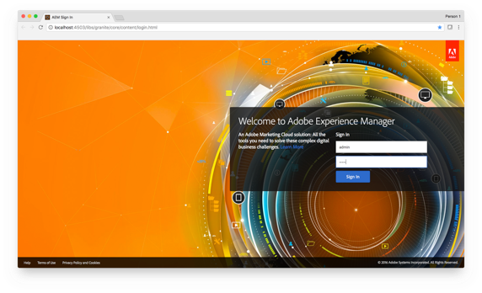
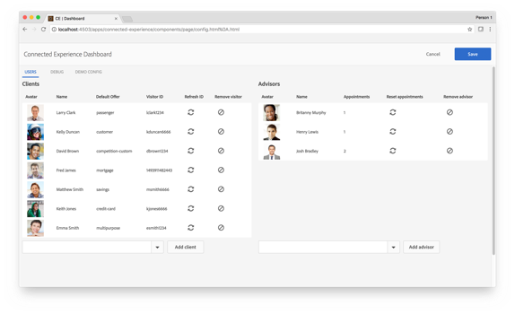
Set up the demo
Start in a new Private/ Incognito browser window
Log in to AEM (admin / admin):
http://localhost:4503/libs/granite/core/content/login.html
After log in click Refresh ID for user Fred James – this
creates a new user profile in Audience Manager
http://localhost:4503/libs/granite/core/content/login.html

Slide 4



Set up the demo
Launch emirates App
Log in as Fred/ fred
See content presented in the app. This is personalised from Target based on profile data

Slide 5
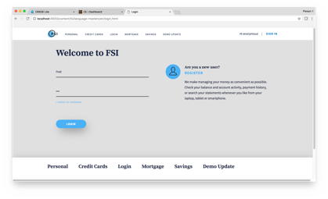
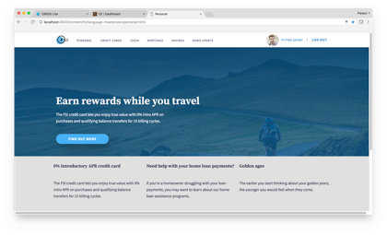
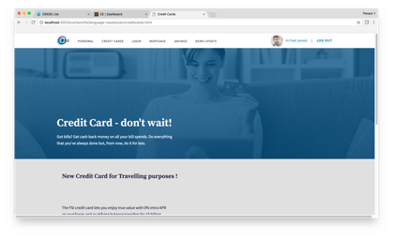
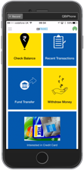
The demo
Log in as Fred/ fred
Home page
Click on Credit Cards in navigation
(Fred’s profile in Audience Manager updated with
trait ‘interestedincreditcard’)
Credit card offer displayed in app (updated profile for
Fred in AAM means he is now in credit card segment
and causes Target offer to be displayed)

Slide 6

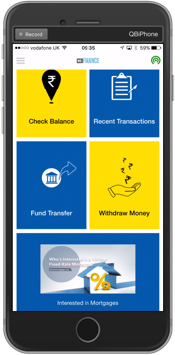
The demo
This is the script:
[Customer] Alexa, Launch Malkins
[Alexa] Welcome to the Malkins
[Customer] Say hello to Alastair
[Alexa] Hello Alastair, how are you today?
[Customer] Send me an email
[Alexa] An email has been sent

Slide 7






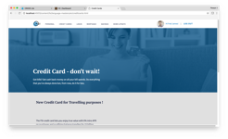


What’s happening where?
Experience Cloud
AWS
Login
Content and Experience Fragments
Content As A Service
Lambda
Monitoring
Dynamo
Track Intent names
Requests
Login
Experiences
Recommendations
Email
Push Notifications
Segments

Slide 8












Alexa Skill Integration with Experience Cloud
Site, Mobile App,
Alexa
Experience Manager
Content and Digital Asset Management
Template Creation and Publication
Content Authoring
Analytics Essentials
Experience Targeting
Individualization
Assets Core Service
Activation Core Service
(RT)
Author Configuration
Images
Analytics
Segments
People
Core Service
Segments
Target
Behavior & Segmentation
Analytics
Historical Segmentation
Web/Mobile Personalization
Behavioral Targeting
A/B Testing
Recommendations
Personalization
Attributes
MC Segment Sharing
CRM Attributes
Attributes
Segments
Data
Audience Manager
Images, Email Templates
Campaign
Ad Networks
(RT & Batch)
Data Portability & Syndication
Look Alike Modeling
3rd Party Data
Segments
(Privacy)
Contact Management
Offer Management
^{Messages}
2nd & 3rd PARTY DATA
Email, Call Center,
Kiosk
Profile Attributes
(Anonymized)
Data
Profile Attributes
Data as a service
Data Aggregation
Data Modeling
Lead Scoring
101010
101010
Customer Data
EDW
CRM
Opt-In Preferences
Products
Customer Attributes
Models
Enriched Data

